Slide 1
CMSC 671
Fall 2005
Class #19 / 22 – Thursday, November 3 / Tuesday, November 15

Slide 2
Bayesian Networks
Chapter 14
Some material borrowed
from Lise Getoor

Slide 3
Today’s class
Bayesian networks
  Network structure
  Conditional probability tables
  Conditional independence
Inference in Bayesian networks
  Exact inference
  Approximate inference

Slide 4

Bayesian Belief Networks (BNs)
Definition: BN = (DAG, CPD)
  DAG: directed acyclic graph (BN’s structure)
    Nodes: random variables (typically binary or discrete, but methods also exist to handle continuous variables)
    Arcs: indicate probabilistic dependencies between nodes (lack of link signifies conditional independence)
  CPD: conditional probability distribution (BN’s parameters)
    Conditional probabilities at each node, usually stored as a table (conditional probability table, or CPT)
  Root nodes are a special case – no parents, so just use priors in CPD:

Slide 5
Example BN
P(A) = 0.001
a
b c
d e
P(C|A) = 0.2 P(C|¬A) = 0.005
P(B|A) = 0.3 P(B|¬A) = 0.001
P(D|B,C) = 0.1 P(D|B,¬C) = 0.01
P(D|¬B,C) = 0.01 P(D|¬B,¬C) = 0.00001
P(E|C) = 0.4 P(E|¬C) = 0.002
Note that we only specify P(A) etc., not P(¬A), since they have to add to one

Slide 6




Conditional independence and chaining
Conditional independence assumption
  where q is any set of variables
  (nodes) other than and its successors
  blocks influence of other nodes on
  and its successors (q influences only
  through variables in )
  With this assumption, the complete joint probability distribution of all variables in the network can be represented by (recovered from) local CPDs by chaining these CPDs:
q

Slide 7
Chaining: Example
a
b c
d e
  Computing the joint probability for all variables is easy:
  P(a, b, c, d, e)
  = P(e | a, b, c, d) P(a, b, c, d) by the product rule
  = P(e | c) P(a, b, c, d) by cond. indep. assumption
  = P(e | c) P(d | a, b, c) P(a, b, c)
  = P(e | c) P(d | b, c) P(c | a, b) P(a, b)
  = P(e | c) P(d | b, c) P(c | a) P(b | a) P(a)

Slide 8
Topological semantics
A node is conditionally independent of its non-descendants given its parents
A node is conditionally independent of all other nodes in the network given its parents, children, and children’s parents (also known as its Markov blanket)
The method called d-separation can be applied to decide whether a set of nodes X is independent of another set Y, given a third set Z

Slide 9
Representational extensions
Even though they are more compact than the full joint distribution, CPTs for large networks can require a large number of parameters (O(2^{k}) where k is the branching factor of the network)
Compactly representing CPTs
  Deterministic relationships
  Noisy-OR
  Noisy-MAX
Adding continuous variables
  Discretization
  Use density functions (usually mixtures of Gaussians) to build hybrid Bayesian networks (with discrete and continuous variables)

Slide 10
Inference tasks
Simple queries: Computer posterior marginal P(X_{i} | E=e)
  E.g., P(NoGas | Gauge=empty, Lights=on, Starts=false)
Conjunctive queries:
  P(X_{i}, X_{j} | E=e) = P(X_{i} | e=e) P(X_{j} | X_{i}, E=e)
Optimal decisions: Decision networks include utility information; probabilistic inference is required to find P(outcome | action, evidence)
Value of information: Which evidence should we seek next?
Sensitivity analysis: Which probability values are most critical?
Explanation: Why do I need a new starter motor?

Slide 11
Approaches to inference
Exact inference
  Enumeration
  Belief propagation in polytrees
  Variable elimination
  Clustering / join tree algorithms
Approximate inference
  Stochastic simulation / sampling methods
  Markov chain Monte Carlo methods
  Genetic algorithms
  Neural networks
  Simulated annealing
  Mean field theory

Slide 12
Direct inference with BNs
Instead of computing the joint, suppose we just want the probability for one variable
Exact methods of computation:
  Enumeration
  Variable elimination
  Join trees: get the probabilities associated with every query variable

Slide 13
Inference by enumeration
Add all of the terms (atomic event probabilities) from the full joint distribution
If E are the evidence (observed) variables and Y are the other (unobserved) variables, then:
    P(X|e) = α P(X, E) = α ∑ P(X, E, Y)
Each P(X, E, Y) term can be computed using the chain rule
Computationally expensive!

Slide 14
Example: Enumeration
a
b c
d e
P(x_{i}) = Σ _{πi} P(x_{i} | π_{i}) P(π_{i})
Suppose we want P(D=true), and only the value of E is given as true
P (d|e) = α Σ_{ABC}P(a, b, c, d, e)
= α Σ_{ABC}P(a) P(b|a) P(c|a) P(d|b,c) P(e|c)
With simple iteration to compute this expression, there’s going to be a lot of repetition (e.g., P(e|c) has to be recomputed every time we iterate over C=true)

Slide 15
Exercise: Enumeration
p(smart)=.8
p(study)=.6
smart
study
p(fair)=.9
prepared
fair
p(prep|…) | smart | ¬smart
study | .9 | .7
¬study | .5 | .1
pass
p(pass|…) | smart |  | ¬smart
 | prep | ¬prep | prep | ¬prep
fair | .9 | .7 | .7 | .2
¬fair | .1 | .1 | .1 | .1
Query: What is the probability that a student studied, given that they pass the exam?

Slide 16
Variable elimination
Basically just enumeration, but with caching of local calculations
Linear for polytrees (singly connected BNs)
Potentially exponential for multiply connected BNs
  Exact inference in Bayesian networks is NP-hard!
Join tree algorithms are an extension of variable elimination methods that compute posterior probabilities for all nodes in a BN simultaneously

Slide 17
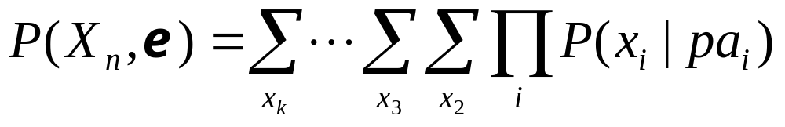
Variable elimination
General idea:
Write query in the form
Iteratively
  Move all irrelevant terms outside of innermost sum
  Perform innermost sum, getting a new term
  Insert the new term into the product

Slide 18
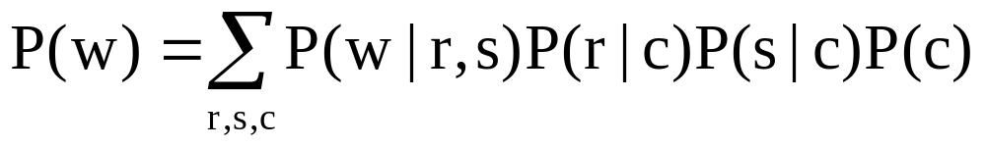
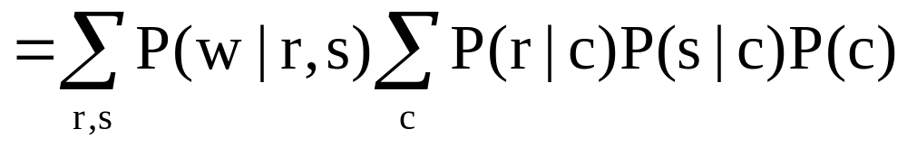
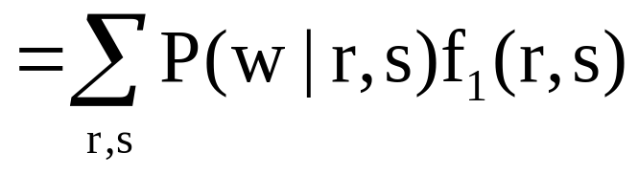
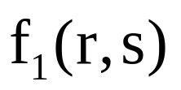
Variable elimination: Example
Cloudy
Sprinkler
Rain
WetGrass

Slide 19
Computing factors
R | S | C | P(R|C) | P(S|C) | P(C) | P(R|C) P(S|C) P(C)
T | T | T
T | T | F
T | F | T
T | F | F
F | T | T
F | T | F
F | F | T
F | F | F
R | S | f₁(R,S) = ∑_{c} P(R|S) P(S|C) P(C)
T | T
T | F
F | T
F | F

Slide 20
A more complex example
“Asia” network:
Visit to
Asia
Smoking
Tuberculosis
Lung Cancer
Abnormality
in Chest
Bronchitis
X-Ray
Dyspnea

Slide 21
V
S
We want to compute P(d)
Need to eliminate: v,s,x,t,l,a,b
Initial factors
T
L
A
B
X
D

Slide 22
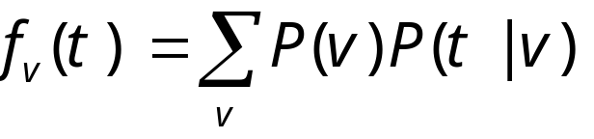
V
S
We want to compute P(d)
Need to eliminate: v,s,x,t,l,a,b
Initial factors
T
L
A
B
X
D
Eliminate: v
Compute:
Note: f_{v}(t) = P(t)
In general, result of elimination is not necessarily a probability term

Slide 23
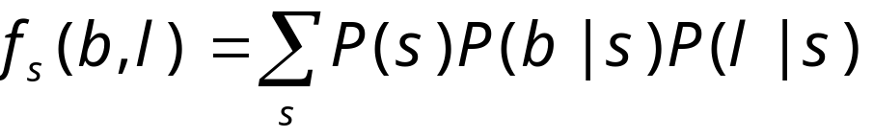
V
S
We want to compute P(d)
Need to eliminate: s,x,t,l,a,b
Initial factors
T
L
A
B
X
D
Eliminate: s
Compute:
Summing on s results in a factor with two arguments f_{s}(b,l)
In general, result of elimination may be a function of several variables

Slide 24
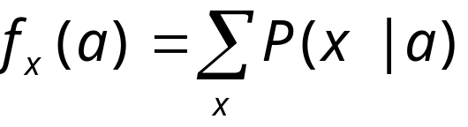
V
S
We want to compute P(d)
Need to eliminate: x,t,l,a,b
Initial factors
T
L
A
B
X
D
Eliminate: x
Compute:
Note: f_{x}(a) = 1 for all values of a !!

Slide 25
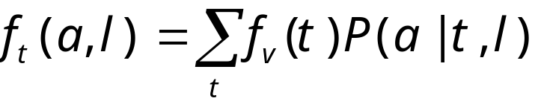
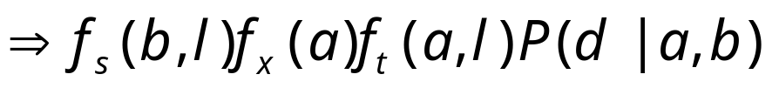
V
S
We want to compute P(d)
Need to eliminate: t,l,a,b
Initial factors
T
L
A
B
X
D
Eliminate: t
Compute:

Slide 26
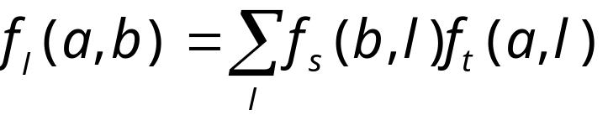
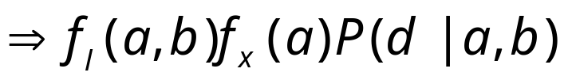
V
S
We want to compute P(d)
Need to eliminate: l,a,b
Initial factors
T
L
A
B
X
D
Eliminate: l
Compute:

Slide 27

V
S
We want to compute P(d)
Need to eliminate: b
Initial factors
T
L
A
B
X
D
Eliminate: a,b
Compute:

Slide 28
Dealing with evidence
V
S
T
L
A
B
How do we deal with evidence?
Suppose we are give evidence V = t, S = f, D = t
We want to compute P(L, V = t, S = f, D = t)
X
D

Slide 29
Dealing with evidence
V
S
T
L
A
B
We start by writing the factors:
Since we know that V = t, we don’t need to eliminate V
Instead, we can replace the factors P(V) and P(T|V) with
These “select” the appropriate parts of the original factors given the evidence
Note that f_{p(V)} is a constant, and thus does not appear in elimination of other variables
X
D

Slide 30
Dealing with evidence
V
S
T
L
Given evidence V = t, S = f, D = t
Compute P(L, V = t, S = f, D = t )
Initial factors, after setting evidence:
A
B
X
D

Slide 31
Dealing with evidence
V
S
T
L
Given evidence V = t, S = f, D = t
Compute P(L, V = t, S = f, D = t )
Initial factors, after setting evidence:
Eliminating x, we get
A
B
X
D

Slide 32
Dealing with evidence
V
S
T
L
Given evidence V = t, S = f, D = t
Compute P(L, V = t, S = f, D = t )
Initial factors, after setting evidence:
Eliminating x, we get
Eliminating t, we get
A
B
X
D

Slide 33
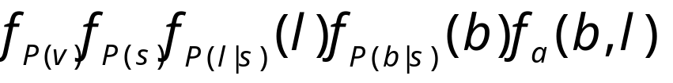
Dealing with evidence
V
S
T
L
Given evidence V = t, S = f, D = t
Compute P(L, V = t, S = f, D = t )
Initial factors, after setting evidence:
Eliminating x, we get
Eliminating t, we get
Eliminating a, we get
A
B
X
D

Slide 34
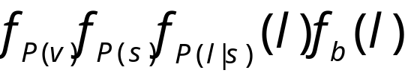
Dealing with evidence
V
S
T
L
Given evidence V = t, S = f, D = t
Compute P(L, V = t, S = f, D = t )
Initial factors, after setting evidence:
Eliminating x, we get
Eliminating t, we get
Eliminating a, we get
Eliminating b, we get
A
B
X
D

Slide 35
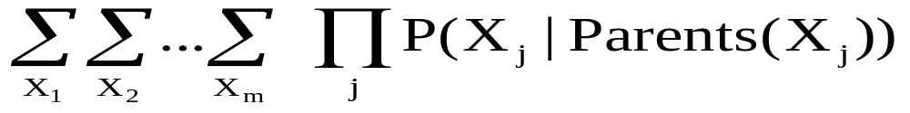
Variable elimination algorithm
Let X₁,…, X_{m} be an ordering on the non-query variables
For i = m, …, 1
  Leave in the summation for X_{i} only factors mentioning X_{i}
  Multiply the factors, getting a factor that contains a number for each value of the variables mentioned, including X_{i}
  Sum out X_{i}, getting a factor f that contains a number for each value of the variables mentioned, not including X_{i}
  Replace the multiplied factor in the summation

Slide 36
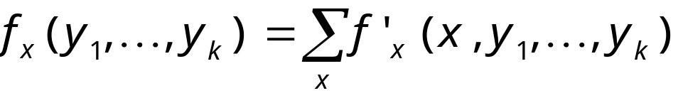
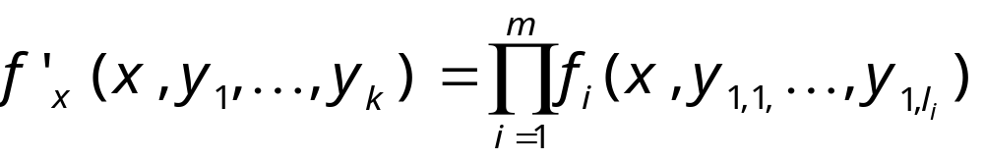
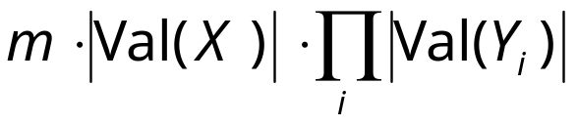
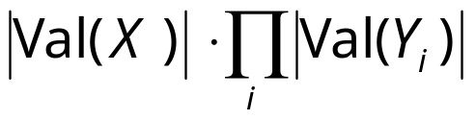
Complexity of variable elimination
Suppose in one elimination step we compute
This requires
multiplications (for each value for x, y₁, …, y_{k}, we do m multiplications) and
additions (for each value of y₁, …, y_{k} , we do |Val(X)| additions)
►Complexity is exponential in the number of variables in the intermediate factors
►Finding an optimal ordering is NP-hard

Slide 37
Exercise: Variable elimination
p(smart)=.8
p(study)=.6
smart
study
p(fair)=.9
prepared
fair
p(prep|…) | smart | ¬smart
study | .9 | .7
¬study | .5 | .1
pass
p(pass|…) | smart |  | ¬smart
 | prep | ¬prep | prep | ¬prep
fair | .9 | .7 | .7 | .2
¬fair | .1 | .1 | .1 | .1
Query: What is the probability that a student is smart, given that they pass the exam?

Slide 38
Conditioning
a
b c
d e
Conditioning: Find the network’s smallest cutset S (a set of nodes whose removal renders the network singly connected)
  In this network, S = {A} or {B} or {C} or {D}
For each instantiation of S, compute the belief update with the polytree algorithm
Combine the results from all instantiations of S
Computationally expensive (finding the smallest cutset is in general NP-hard, and the total number of possible instantiations of S is O(2^{|S|}))

Slide 39
Approximate inference:
Direct sampling
Suppose you are given values for some subset of the variables, E, and want to infer values for unknown variables, Z
Randomly generate a very large number of instantiations from the BN
  Generate instantiations for all variables – start at root variables and work your way “forward” in topological order
Rejection sampling: Only keep those instantiations that are consistent with the values for E
Use the frequency of values for Z to get estimated probabilities
Accuracy of the results depends on the size of the sample (asymptotically approaches exact results)

Slide 40
Exercise: Direct sampling
p(smart)=.8
p(study)=.6
smart
study
p(fair)=.9
prepared
fair
p(prep|…) | smart | ¬smart
study | .9 | .7
¬study | .5 | .1
pass
p(pass|…) | smart |  | ¬smart
 | prep | ¬prep | prep | ¬prep
fair | .9 | .7 | .7 | .2
¬fair | .1 | .1 | .1 | .1
Topological order = …?
Random number generator: .35, .76, .51, .44, .08, .28, .03, .92, .02, .42

Slide 41
Likelihood weighting
Idea: Don’t generate samples that need to be rejected in the first place!
Sample only from the unknown variables Z
Weight each sample according to the likelihood that it would occur, given the evidence E

Slide 42
Markov chain Monte Carlo algorithm
So called because
  Markov chain – each instance generated in the sample is dependent on the previous instance
  Monte Carlo – statistical sampling method
Perform a random walk through variable assignment space, collecting statistics as you go
  Start with a random instantiation, consistent with evidence variables
  At each step, for some nonevidence variable, randomly sample its value, consistent with the other current assignments
Given enough samples, MCMC gives an accurate estimate of the true distribution of values

Slide 43
Exercise: MCMC sampling
p(smart)=.8
p(study)=.6
smart
study
p(fair)=.9
prepared
fair
p(prep|…) | smart | ¬smart
study | .9 | .7
¬study | .5 | .1
pass
p(pass|…) | smart |  | ¬smart
 | prep | ¬prep | prep | ¬prep
fair | .9 | .7 | .7 | .2
¬fair | .1 | .1 | .1 | .1
Topological order = …?
Random number generator: .35, .76, .51, .44, .08, .28, .03, .92, .02, .42

Slide 44
Summary
Bayes nets
  Structure
  Parameters
  Conditional independence
  Chaining
BN inference
  Enumeration
  Variable elimination
  Sampling methods

